Slide 1

PHYSICAL ACTIVITY APROXIMATION USING POSE ESTIMATION AND HUMAN ACTIVITY RECOGNITION
GUIDE:
DR. SREE SHARMILA T
RAGHUL PRANAVESH M - 2020103555
HARI PRASATH S - 2020103012
VELMURUGAN J - 2020103585

Slide 2



PREVIOUS REVIEW COMMENTS
Add detailed module diagrams .
Accumulate domain knowledge ( ground truth ).
Provision of performance metrics.

Slide 3
INTRODUCTION
The proposed work aims to leverage the concepts of human activity recognition and pose estimation techniques to build an application that performs the role of an exercise tracker
The primary role of the system includes to perform a classification task on the video input of the user, to sketch a joint based co-ordination diagram of the user at that point of time, use the same to compare and count repetitions of the exercise being performed, calories burnt, daily activities et cetera
A deep learning model is used to train the system and a rule based approach is employed to count the repetitions.

Slide 4
OVERALL OBJECTIVES
To develop a deep learning based system for precise assessment of human posture
To recognize the exercises using deep learning algorithms
To automatically count the repetitions of the exercises being performed, and estimate the calories burnt, daily physical activity of the user.

Slide 5


LITERATURE SURVEY
S NO. | Paper Title, Author, Publication, Year | Methodology | Advantages | Limitations
1. | Video based exercise recognition and correct pose detection Tushar Rangari, Sudhanshu Kumar; Partha Pratim Roy; Debi Prosad Dogra; Byung-Gyu Kim. Multimedia Tools and Applications , 2022. | The model proposes fetching skeleton joints (18 points) from the image with the help OpenPose and feed them as input to the LSTM classifier for the purpose of classifying the exercise. | The model can be applied to larger datasets and would work if the training includes learning through multiple views from different angles. The model performs better than existing works and achieved an accuracy of 97.01%. | Being a 2D model, this may not accurately represent the depth or true 3D spatial information of the movement leading to inaccuracies.
2. | A real-time algorithm for weight training detection and correction Chen-Yi Lin; Kuan-Cheng Jian. Soft Computing - A Fusion of Foundations, Methodologies and Applications Volume 26 Issue 10 May 2022 | The paper proposes combining OpenPose with webcams and developing the WTPose algorithm which can determine a weight trainee’s posture and display the correct posture. | The WTPose algorithm can accurately and quickly determine whether trainee's weight training posture is correct. The proposed algorithm provides corresponding corrective message for selective exercises. | In order to improve the overall accuracy, 3D human posture detection methods could be employed to track the body skeleton. It is also possible to increase the system's functionality to include other sports.

Slide 6
LITERATURE SURVEY
S NO. | Paper Title, Author, Publication, Year | Methodology | Advantages | Limitations
3. | Human pose estimation and action recognition for fitness movements Huichen Fu, Junwei Gao, Huabo Liu. Computers & Graphics, September 2023 | This paper proposes an improved YOLOv7-Pose algorithm and an improved ConvNeXt network structure is introduced to replace the convolution kernel of the original model to improve the accuracy of human key point detection and action classification of the model. | YOLOv7-Pose directly trains the model end-to-end, significantly improving the speed of training and reasoning. ConvNeXt proves more suitable for image detection as well as reduce the computational effort. | The proposed model does not adequately account for the diversity of human body types, movements, or cultural factors leading to misclassifications and errors in pose estimation and action recognition.
4. | Human Pose Estimation Using MediaPipe Pose and Optimization Method Based on a Humanoid Model Jong-Wook Kim , Jin-Young Choi, Eun-Ju Ha and Jae-Ho Choi. Applied Sciences, 2023. | The paper proposes an off-the-shelf 2D pose estimation method, MediaPipe Pose and combines a more sophisticated humanoid model with a fast optimization method to estimate joint angles for 3D pose estimation. | MediaPipe allows custom backbones networks for its implementation in contrary to other models. MediaPipe simplifies retraining without the need for modifying network architectures and re-implementing downstream processing. | Mediapipe is only able to support single person pose estimation and doesnot support real-time multi-person pose estimations.

Slide 7
LITERATURE SURVEY
S NO. | Paper Title, Author, Publication, Year | Methodology | Advantages | Limitations
5. | Machine Learning-Based Exercise Posture Recognition System Using MediaPipe Pose Estimation Framework Weeriya Supanich, Suwanee Kulkarineetham, Parinya Sukphokha, Patcharathon Wisarnsart. 2023 9th International Conference on Advanced Computing and Communication Systems (ICACCS) | The model proposes that we extract body skeleton sequences using the MediaPipe pose estimation framework and evaluate the performance of different machine learning models in detecting each posture class in each type of exercise using precision, recall, and accuracy metrics. | The experimental had high performance in detecting and distinguishing exercise classes. The system achieved an average accuracy score of 100% on test data on three types of exercises. | We could expand the dataset to include more exercises and individuals of varying ages and fitness levels. We could incorporate more advanced machine learning techniques such as deep learning models to further improve the system's ability to recognize complex exercise movements.
6. | Exercise detection and tracking using MediaPipe BlazePose and Spatial-Temporal Graph Convolutional Neural Network Krishnanunni Raju. | This system proposes a deep-learning model based on a pose estimation framework and the Spatial-temporal Graph Convolutional Network that can track and classify exercises performed by humans into different categories. | MediaPipe BlazePose is used to extract the skeleton information from a moving individual and provides 33 key points of the body. | The model can be improved to recognize a greater variety of typically performed actions because it has only been evaluated for a limited subset of possible activities. A lot of computation power would need to be used for training in this case.

Slide 8
SUMMARY OF ISSUES
Most pretrained models struggle to extend to multi person, real time pose estimation but perform exceedingly well when limited to single person pose estimation
The computing power required to build and run such a model is significantly high
The absence of 3D models limits the ability to accurately reflect 3D spatial information such as depth, leading to inaccuracies

Slide 9
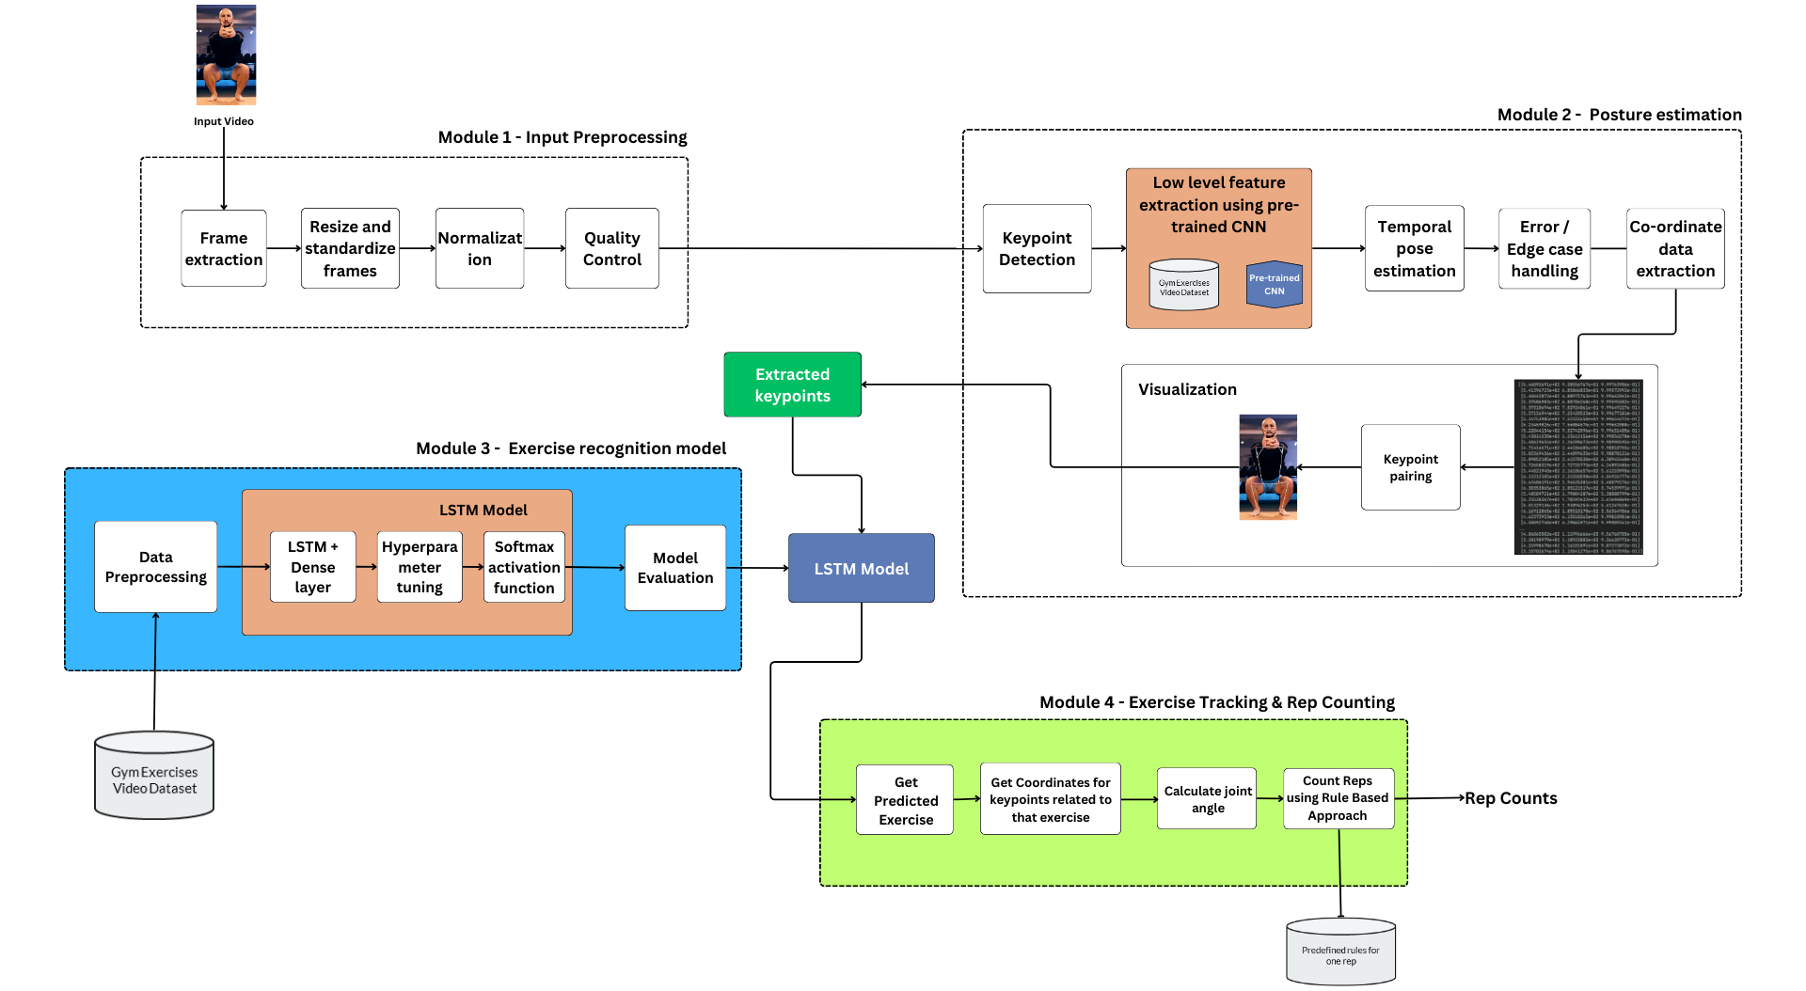
ARCHITECTURE DIAGRAM
Co-ordinate data extraction

Slide 10
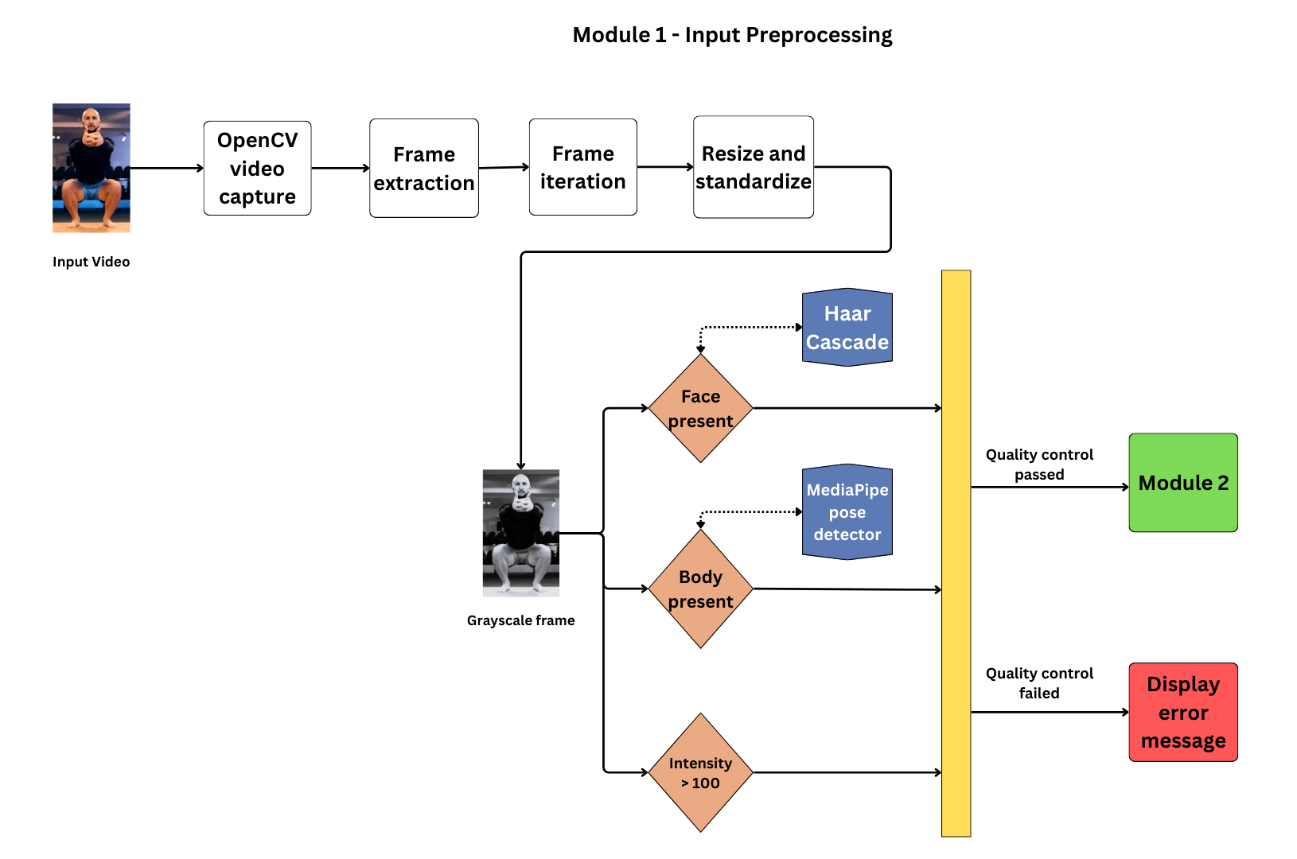
ARCHITECTURE OF MODULE I

Slide 11
MODULE I
INPUT PREPROCESSING
INPUT → Video Input
OUTPUT → Preprocessed Video Frames
ALGORITHM:
Open the video file specified by the video path.
Create a counter frame number to keep track of the processed frames.
Loop through the video frames while it's open:
a. Read the next frame from the video.
b. If there are no more frames, exit the loop.
For each frame, Save the frame as an image in an output directory with a filename that includes frame number.
Standardize the frame by resizing it to a common size (e.g., 640x480 pixels).
Apply image enhancement techniques, such as improving contrast or sharpness, to the standardized frame.
Normalize the pixel values in the frame, usually by scaling them to a range between 0 and 1.
Check the frame's quality:
a. can be evaluated for aspects like motion blur, low contrast, or other quality issues.
b. If the frame is of low quality based on your criteria, skip it and continue to the next frame.
Continue processing frames until you've processed the entire video.
Close the video file.
z

Slide 12
PSEUDOCODE (PYTHON)
function():
process video file using cv2
set frame count to zero
while frame is available in video:
ret, frame = cap.read()
break if frame not available
cv2.imwrite(filename, frame)

Slide 13
resize and standardize the frame
enhance the standardized frame
normalise the enhanced_frame
if normalized_frame is of low quality: continue
cv2.imwrite(preprocessed_frame_filename, normalized_frame)
increase frame count by 1
cap.release()

Slide 14
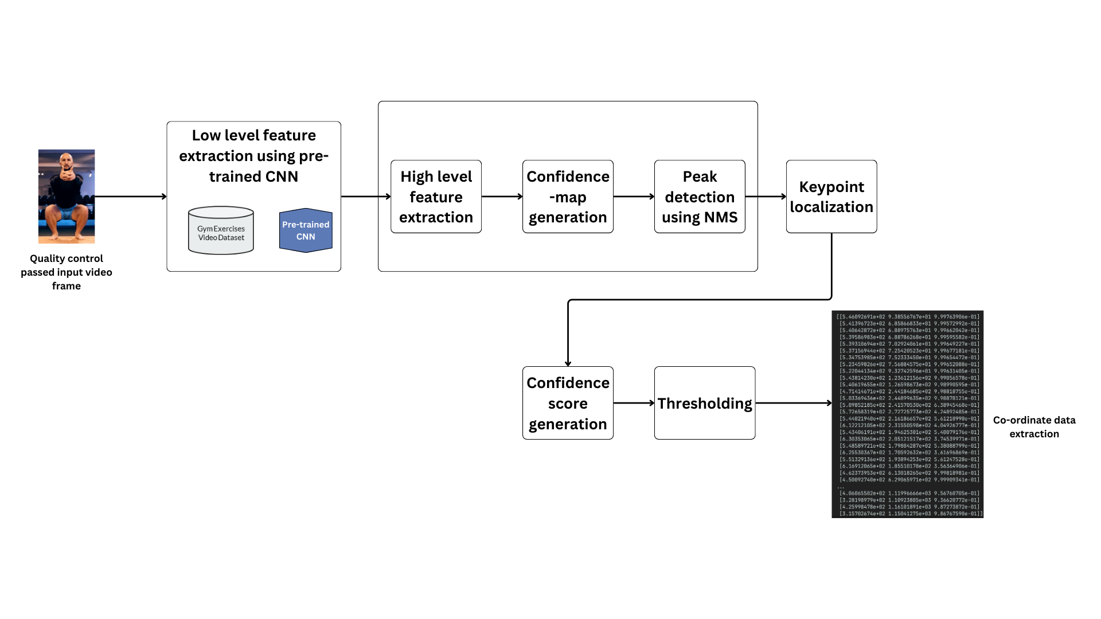
ARCHITECTURE OF MODULE II

Slide 15
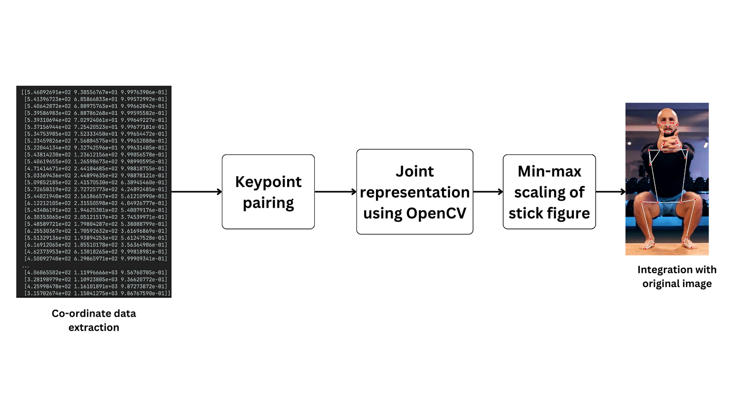
ARCHITECTURE OF MODULE II

Slide 16
MODULE II
POSTURE ESTIMATION
INPUT → Preprocessed Video Frames
OUTPUT → Joint Coordinates
ALGORITHM:
Initialize MediaPipe
Use MediaPipe to find the body keypoints (like the head, shoulders, elbows, etc.) in each frame or image.
If needed, make the detected poses look smoother or more accurate.
If necessary, make the poses look more stable over a series of frames.
Check if keypoints couldn't be detected properly and handle any problems.
Get the exact positions (coordinates) of the body joints from the detected keypoints.
Keep doing these steps for each frame or image until you're done.

Slide 17
PSEUDOCODE (PYTHON)
import openpose
initialize openpose
while more frames is available:
get next frame
detect keypoints from frame using openpose
if keypoints is None: handle_error()
else:
joint_coordinates = extract_coordinates(keypoints)
process_data(joint_coordinates)
openpose.shutdown()

Slide 18
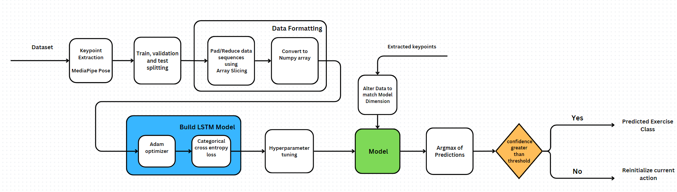
ARCHITECTURE OF MODULE III

Slide 19
MODULE III
EXERCISE RECOGNITION
INPUT → Joint Coordinates
OUTPUT → Exercise class
ALGORITHM:
Create an empty deep LSTM model with necessary parameters.
Load a dataset containing human joint coordinates and their corresponding exercise classes.
Split this dataset into two parts: one for training the model and another for validation.
Train the model using the training dataset. Specify the number of training epochs and batch size.
Once training is complete, your model is ready for predictions.
Prepare the new input data, which is the human joint coordinates you want to predict exercise classes for.
Use the trained model to make predictions. This will give you a set of scores or probabilities for each exercise class.
Convert these scores into a final exercise class prediction. You might choose the exercise class with the highest score as the predicted class.
The variable predicted class now holds the predicted exercise class based on the provided joint coordinates.
z

Slide 20
PSEUDOCODE (PYTHON)
create deep LSTM model
load labeled data
training_data, validation data = split dataset into training and validation
train LSTM model
preprocessed_data = preprocess human joint coordinates data
predicted_scores = model.predict(preprocessed_data)
classify exercise using predicted_scores

Slide 21
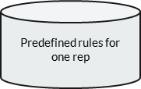
ARCHITECTURE OF MODULE IV
- EXERCISE TRACKING & REP COUNTING
Calculate Joint Angle & Distance
Predicted Exercise Label from
Previous module
Get Coordinates of keypoints related to that exercise
Convert the coordinates to vector
Apply dot product of vectors
Calculate vector Magnitude
Calculate distance between the joints
(option block)
Apply inverse of cosine and convert to degrees
Get the cosine angle between the vectors
Count Reps using Rule Based Approach
Rep count

Slide 22
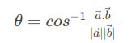
MODULE IV
EXERCISE TRACKING & REP COUNTING
INPUT → Joint Coordinates + Exercise Class
OUTPUT → Rep Counts
ALGORITHM:
Let’s just assume the predicted exercise is Curls.
For each video frame,
1) Get Coordinates for Shoulder, Elbow, Wrist.
2) Calculate Elbow Angle.
- For Vectors joining the coordinates a(Shoulder,Elbow) and b(Elbow, Wrist), the Elbow Angle can be calculated using the formula,
,

Slide 23
MODULE IV
EXERCISE TRACKING & REP COUNTING
INPUT → Joint Coordinates + Exercise Class
OUTPUT → Rep Counts
ALGORITHM:
3) Use Global - Exercise State and Rep Count
4) If the elbow angle exceeds 140 degrees and the current state is Start State, set the
state to "down".
5) If the angle is less than 30 degrees, it signifies the starting position of the curl ("up").
6) If the angle exceeds 140 degrees and the current state is "up", it indicates the completion
of a rep. Increment Rep Count.
7) If End of Video, terminate and return Rep Count.

Slide 24
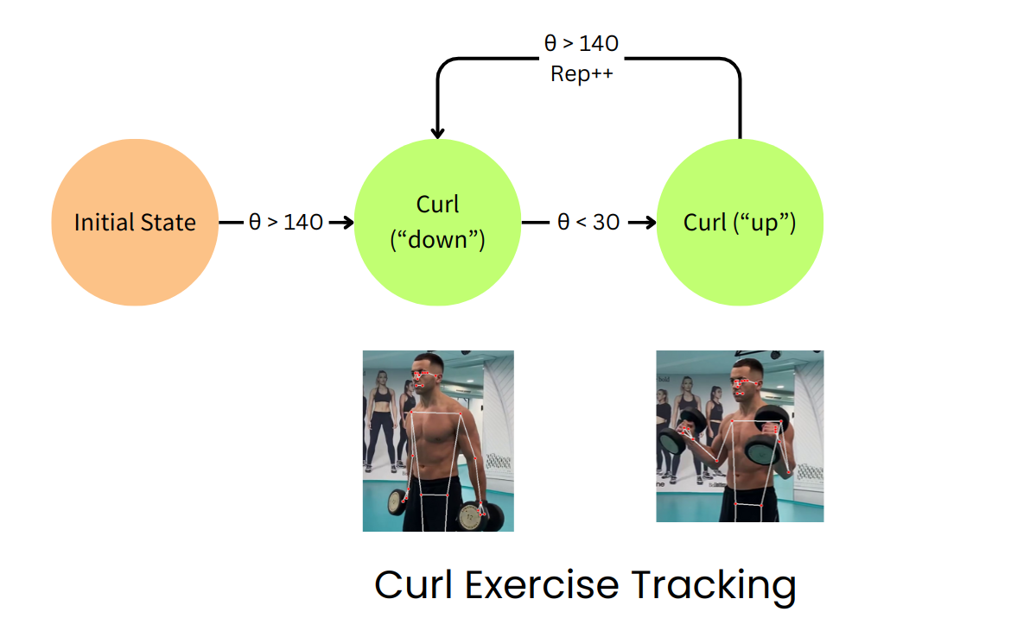
MODULE IV
EXERCISE TRACKING & REP COUNTING

Slide 25
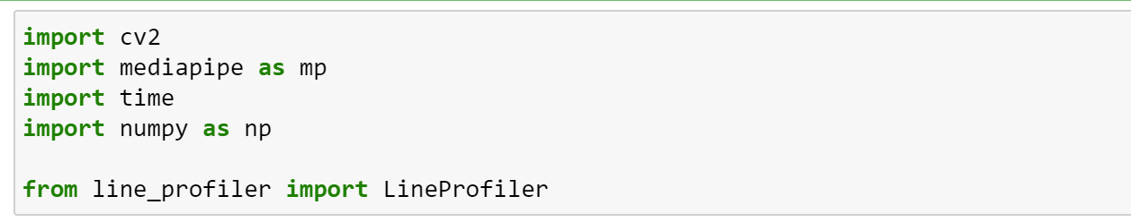
30% IMPLEMENTATION
Importing the libraries:
OpenCV
MediaPipe
Numpy
LineProfiler

Slide 26
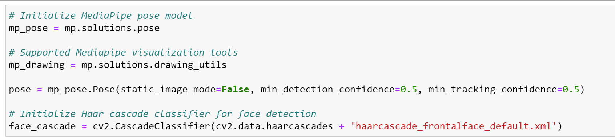
30% IMPLEMENTATION
Initializing the pre-built model
MediaPipe - key point detection model
Haar Cascade - Face detection model

Slide 27
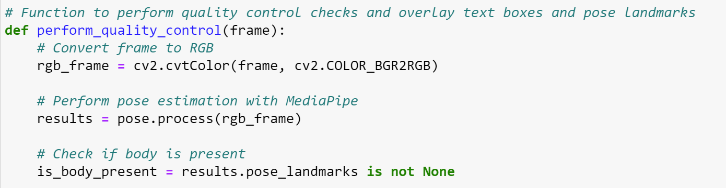
30% IMPLEMENTATION
Quality control checks
Presence of a person - face + body
Proper lighting conditions

Slide 28
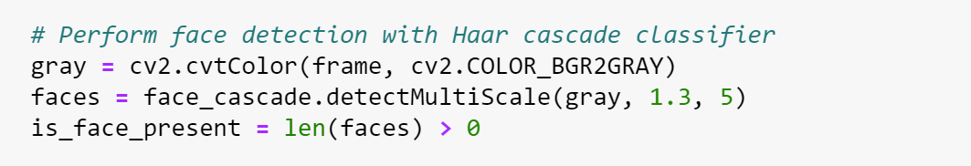
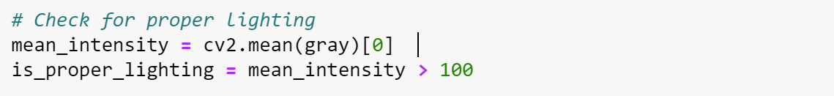
30% IMPLEMENTATION
Quality control checks
Presence of a person - face + body
Proper lighting conditions

Slide 29
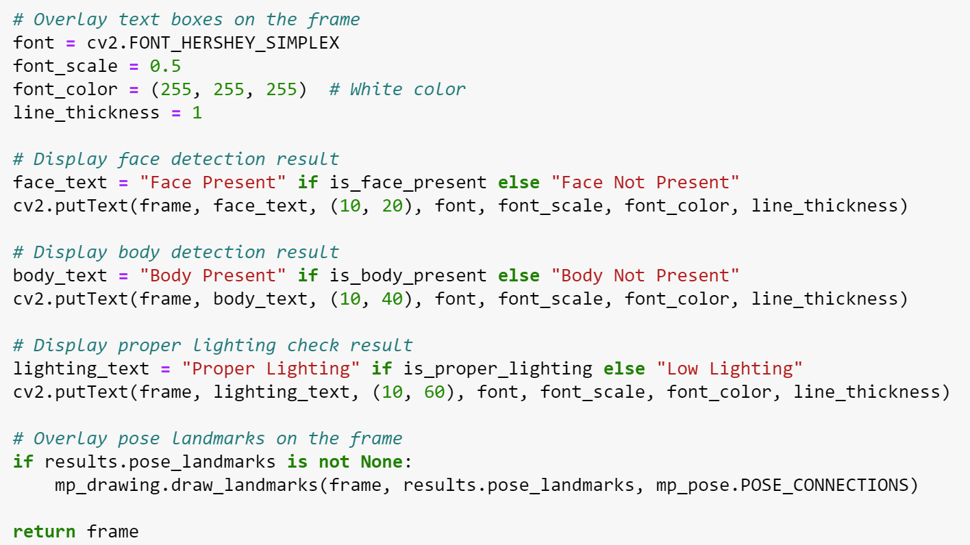
30% IMPLEMENTATION

Slide 30
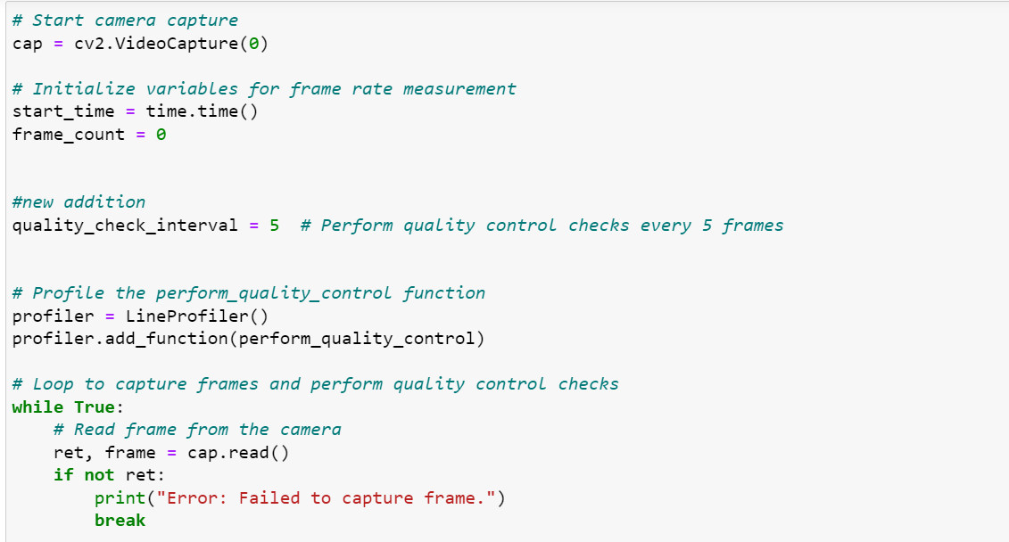
30% IMPLEMENTATION
Driver code

Slide 31
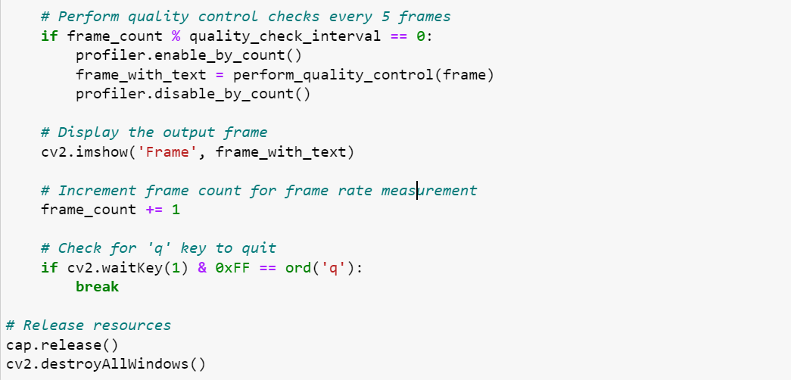
30% IMPLEMENTATION
Driver code

Slide 32
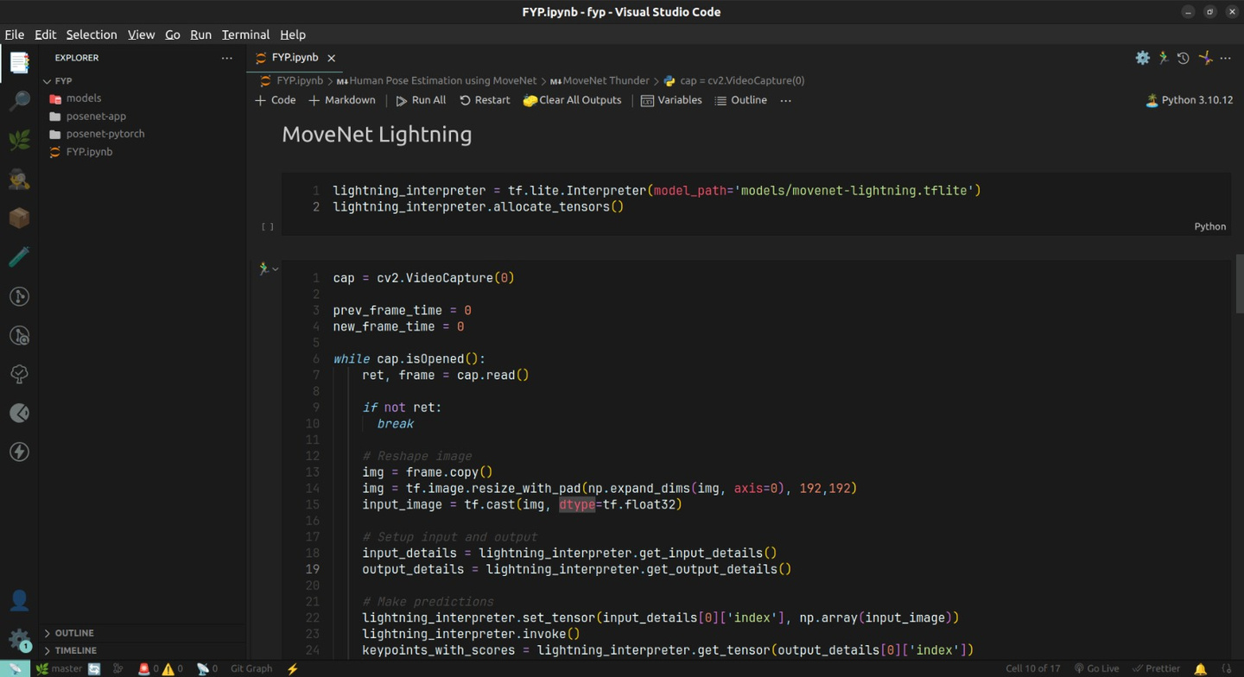
30% IMPLEMENTATION
MoveNet Lightning model

Slide 33
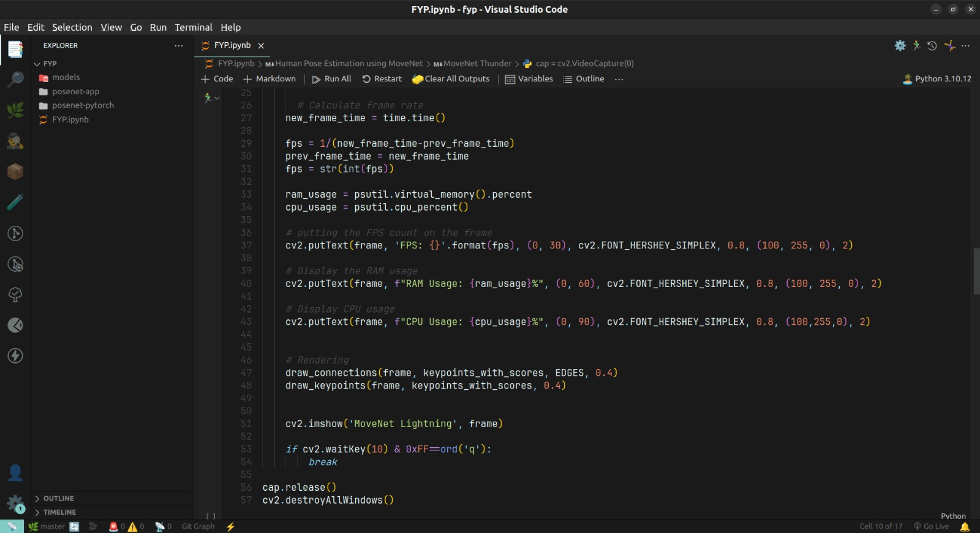
30% IMPLEMENTATION
MoveNet Lightning model

Slide 34
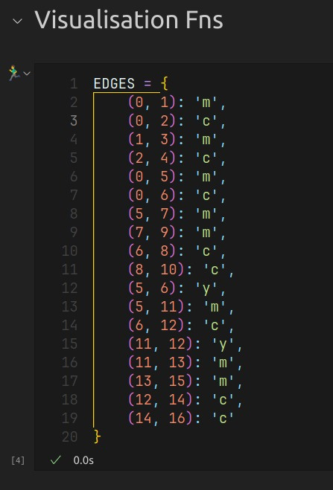
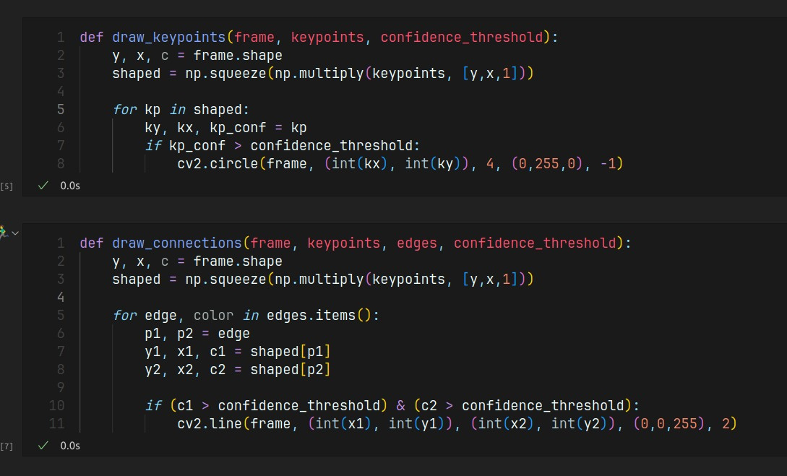
30% IMPLEMENTATION
Visualization functions

Slide 35
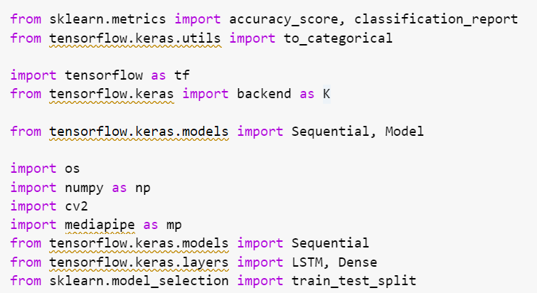
80% IMPLEMENTATION
Code - Pose Classification

Slide 36
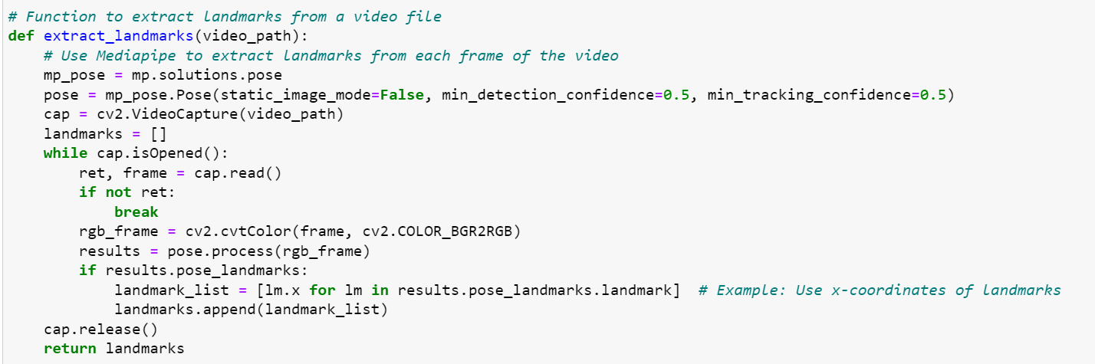
80% IMPLEMENTATION
Code - Pose Classification

Slide 37
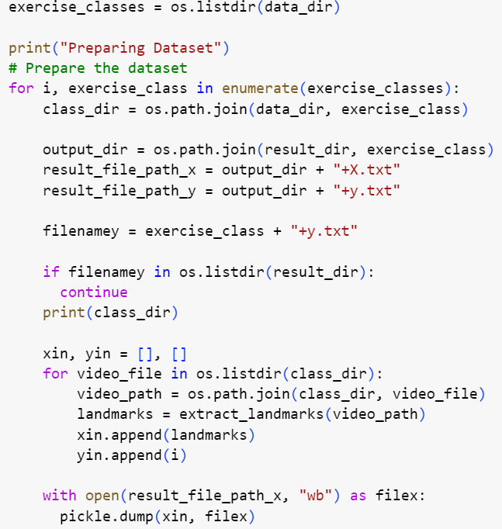
80% IMPLEMENTATION
Code -
Pose
Classification

Slide 38
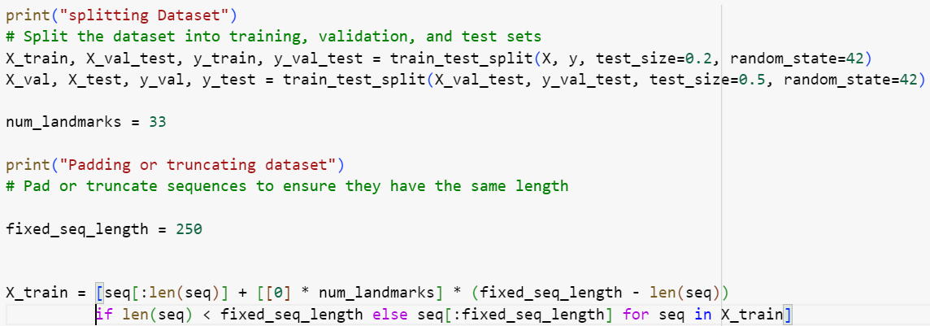
80% IMPLEMENTATION
Code - Pose Classification

Slide 39
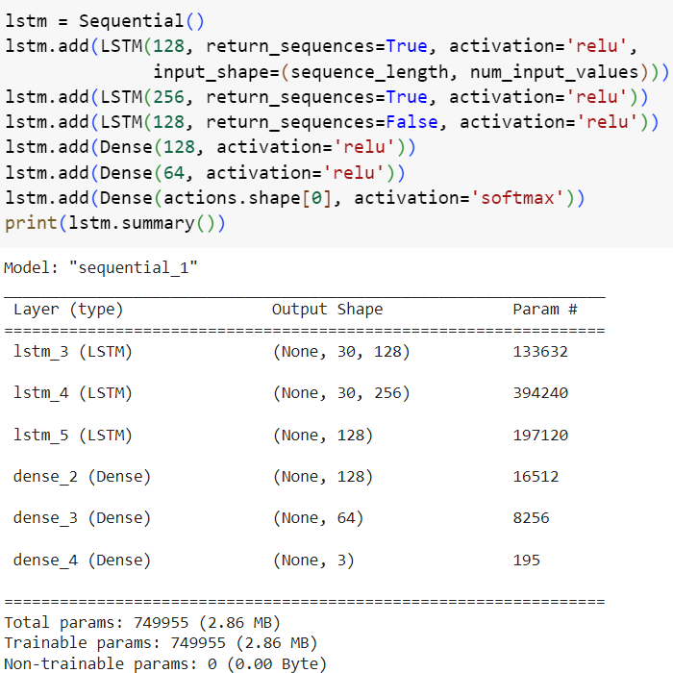
80% IMPLEMENTATION
Code -
Pose
Classification

Slide 40
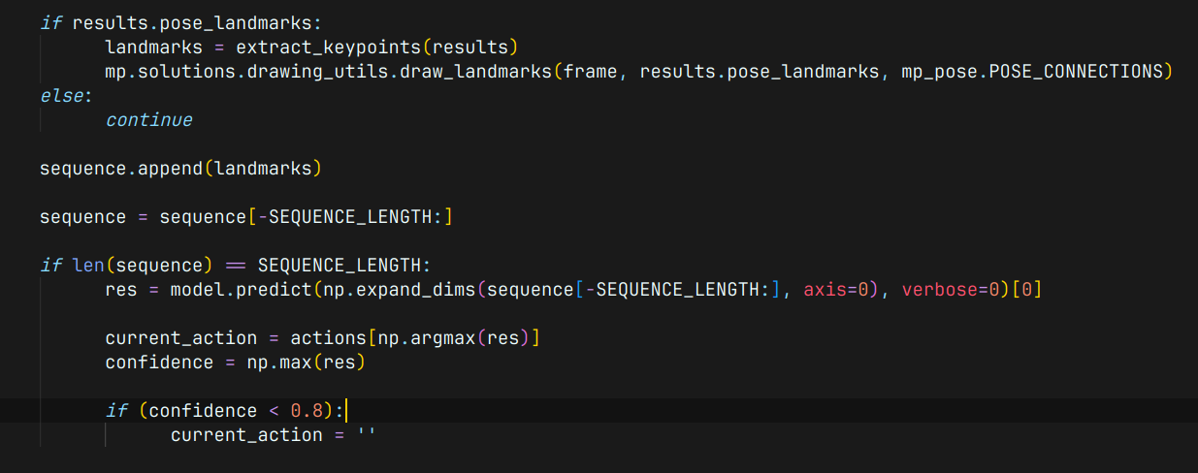
80% IMPLEMENTATION
Code - Pose Classification

Slide 41
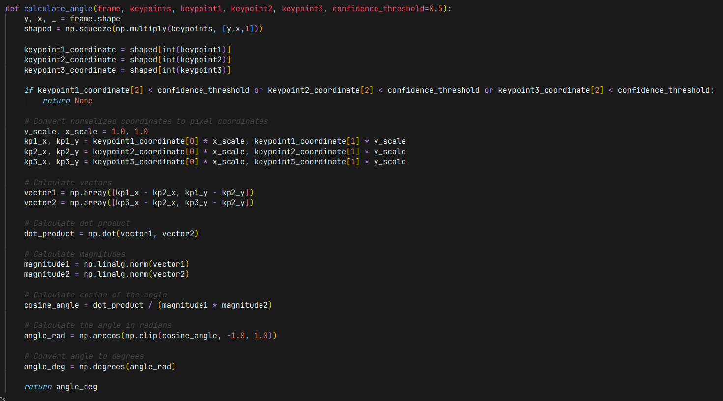
80% IMPLEMENTATION
Code - Exercise Tracking And Rep Counting

Slide 42
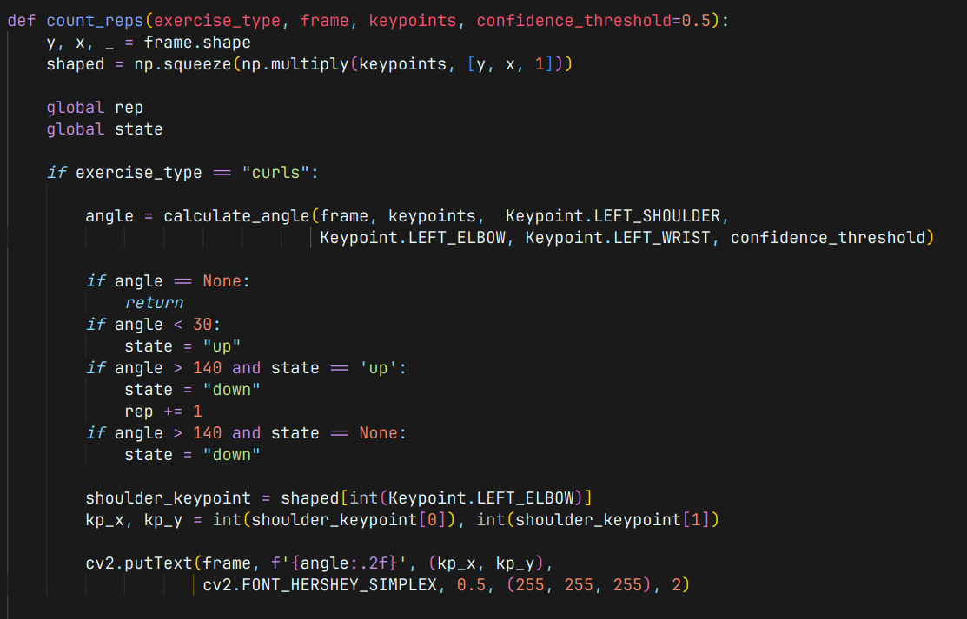
80% IMPLEMENTATION
Code - Exercise Tracking And Rep Counting

Slide 43
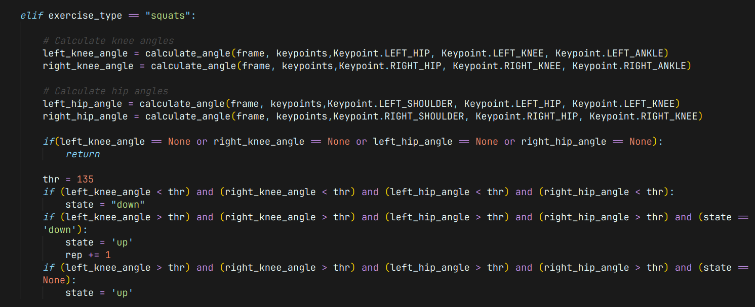
80% IMPLEMENTATION
Code - Exercise Tracking And Rep Counting

Slide 44
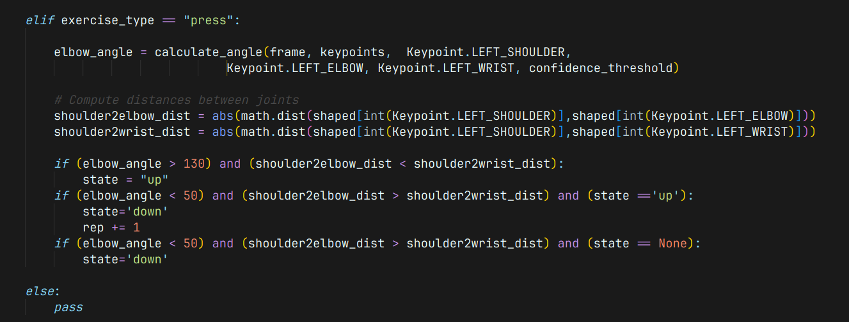
80% IMPLEMENTATION
Code - Exercise Tracking And Rep Counting

Slide 45
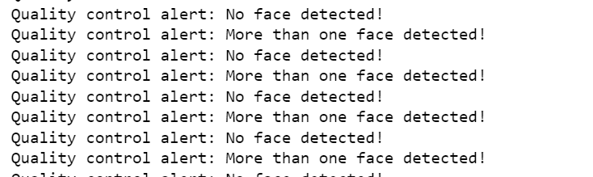
30% IMPLEMENTATION
RESULTS
Low accuracy - high computation model

Slide 46
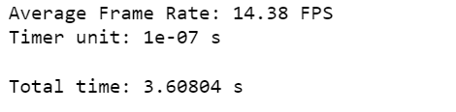
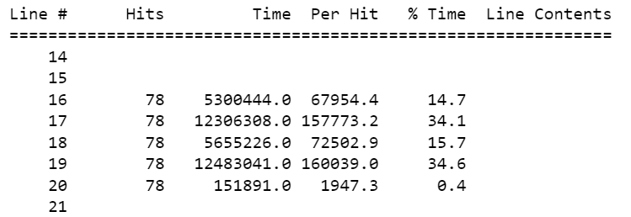
30% IMPLEMENTATION
RESULTS
Low accuracy - high computation model

Slide 47
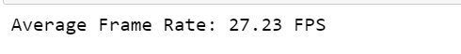
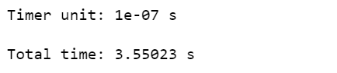
30% IMPLEMENTATION
RESULTS
Higher accuracy - low compute model

Slide 48
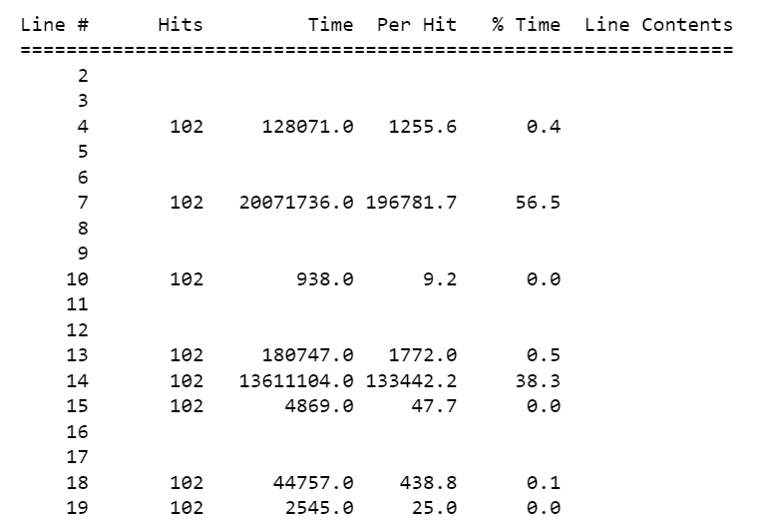
30% IMPLEMENTATION
RESULTS
Higher accuracy - low compute model

Slide 49
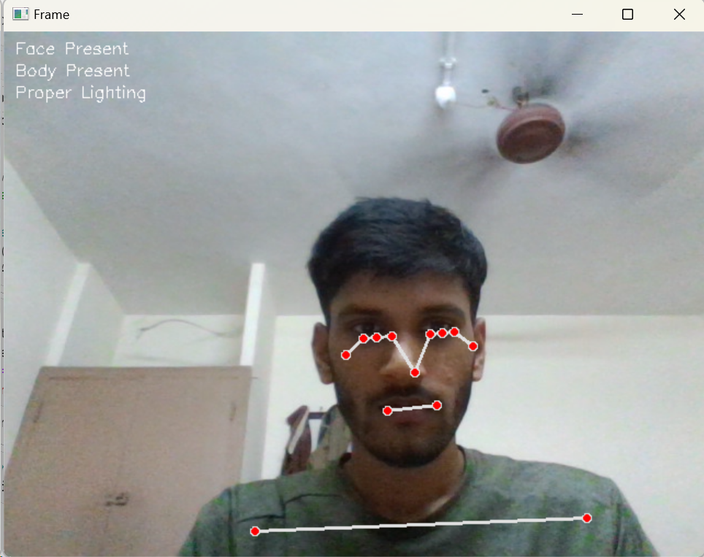
30% IMPLEMENTATION
RESULTS

Slide 50
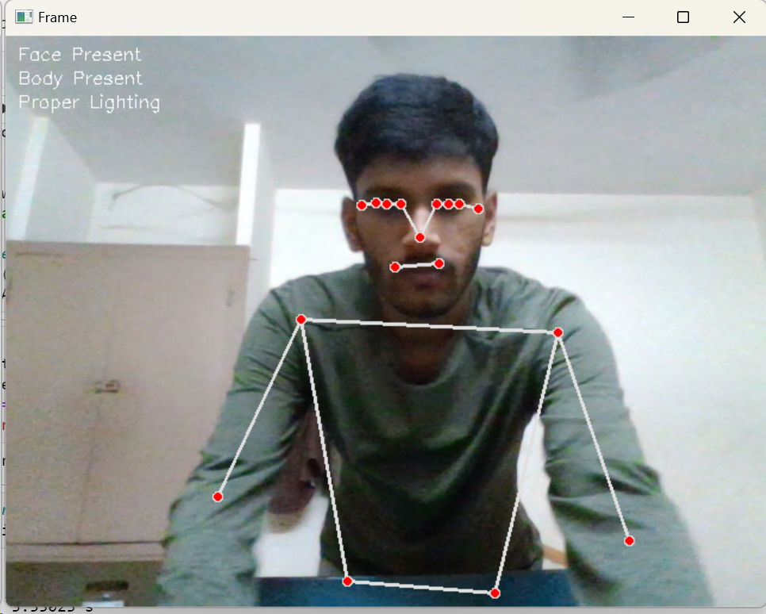
30% IMPLEMENTATION
RESULTS

Slide 51
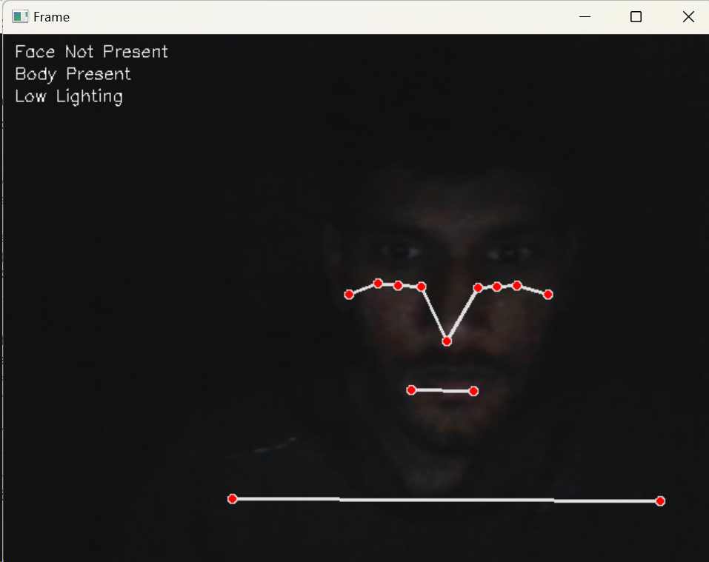
30% IMPLEMENTATION
RESULTS

Slide 52
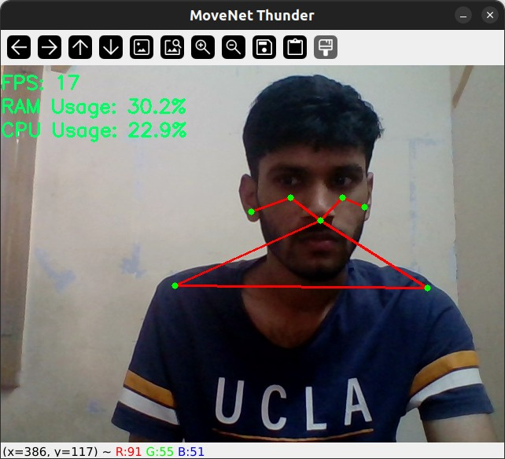
30% IMPLEMENTATION
RESULTS
RAM and CPU usage of Movenet thunder

Slide 53
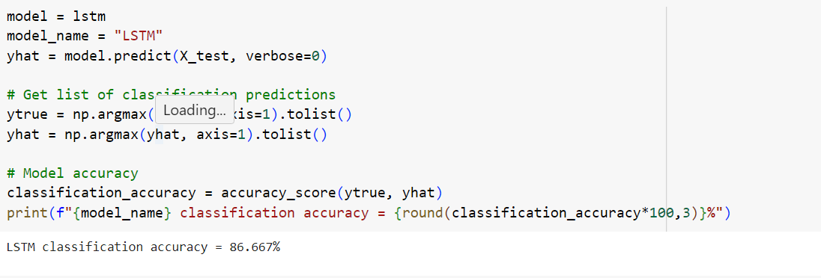
80% IMPLEMENTATION
RESULTS
LSTM MODEL CLASSIFICATOIN ACCURACY

Slide 54
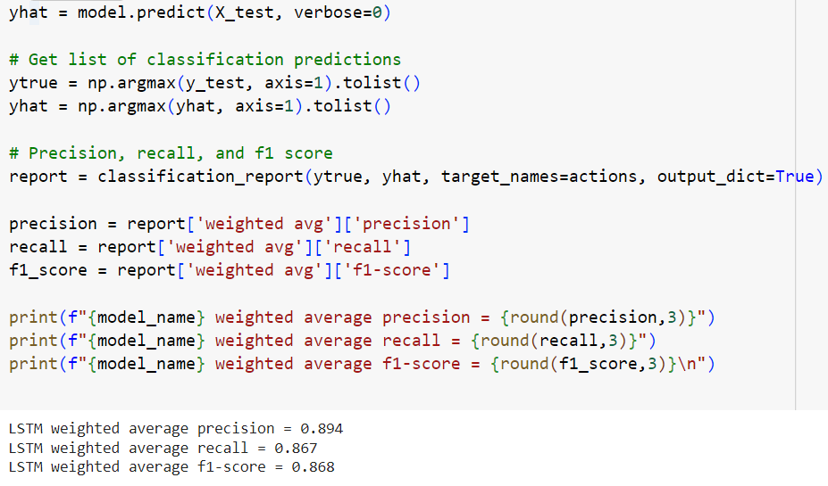
80% IMPLEMENTATION
RESULTS
LSTM MODEL
PRECISION,
RECALL,
F-1 SCORE

Slide 55
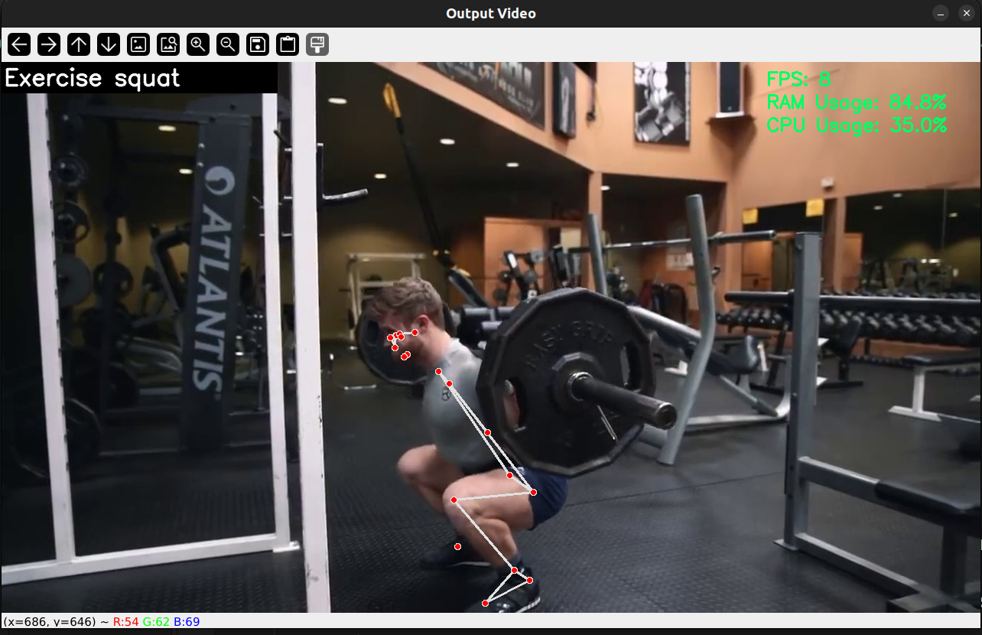
80% IMPLEMENTATION
RESULTS

Slide 56
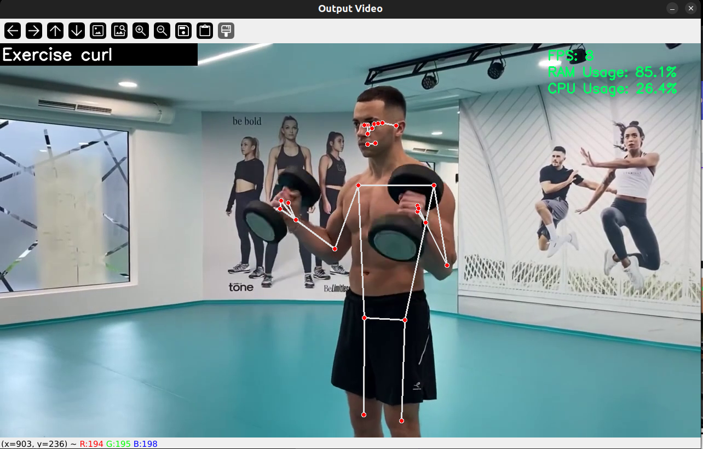
80% IMPLEMENTATION
RESULTS

Slide 57
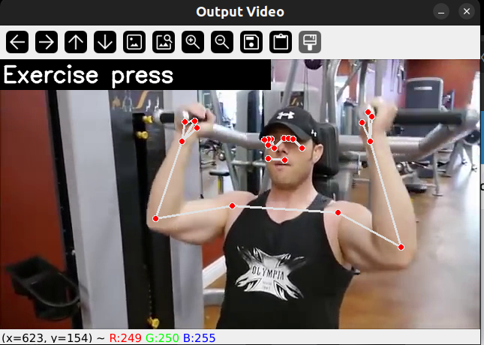
80% IMPLEMENTATION
RESULTS

Slide 58
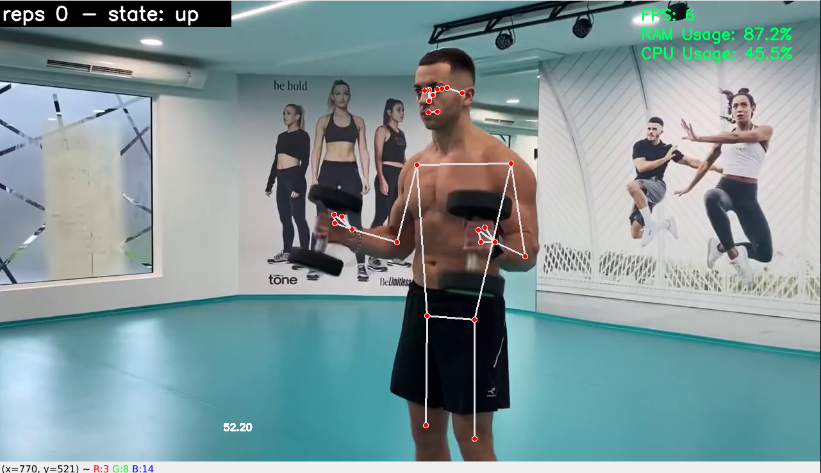
80% IMPLEMENTATION
RESULTS

Slide 59
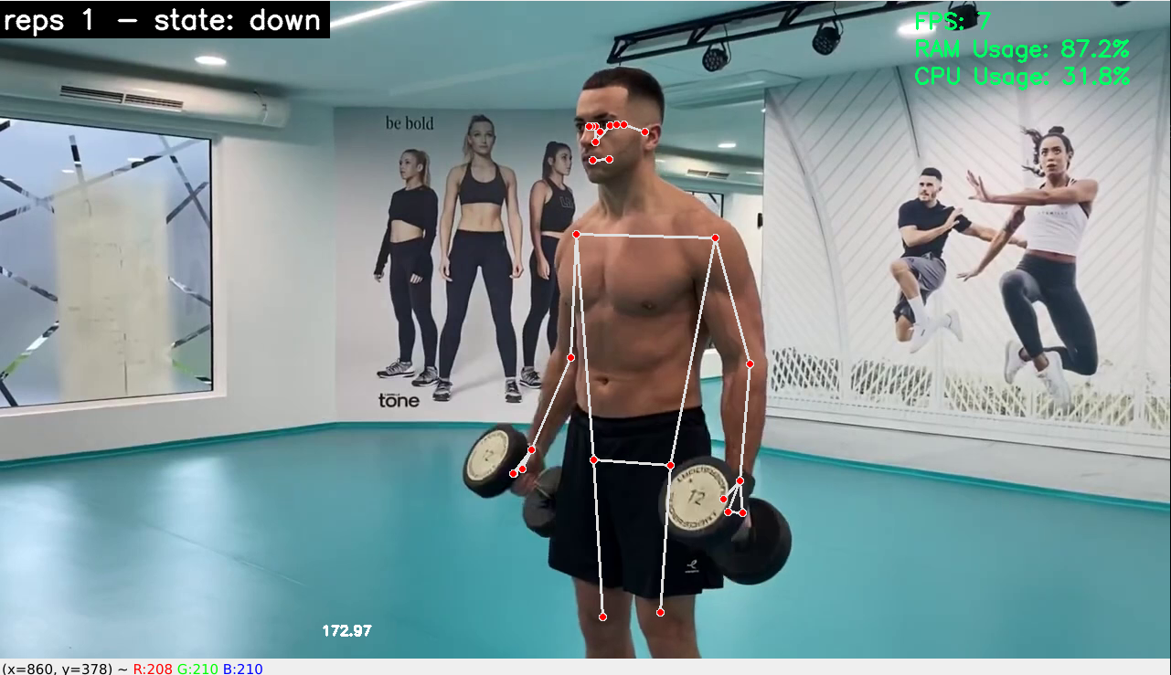
80% IMPLEMENTATION
RESULTS

Slide 60
PERFORMANCE MEASURES
1. Precision
Precision is the closeness of values to each other.
Precision = TP / (TP + FP)
High precision indicates that when the model predicts a positive result, it is likely to be correct.
2. Recall
Recall is a measures of a model's ability to identify all relevant instances of the positive class.
Recall = TP / (TP + F N )
3. Accuracy
Accuracy is the closeness of the value to the true value.
Accuracy = (TP + TN) / (TP + TN + FP + FN)
High accuracy indicates that the model's overall predictions are correct.
4. Confusion Matrix
A confusion matrix is a table that is used to define the performance of a classification algorithm.

Slide 61
DATASET DESCRIPTION
Gym Workout: (22 exercises)
Source: Kaggle (Scraped from Youtube)
This dataset contains videos of people doing workouts. The name of the existing workout corresponds to the name of the folder listed.
The videos are in good resolution, taken in well illuminated rooms, without any occlusion.
Some of the videos are muted.
Video format: .mp4
Video Dataset (4.9 GB):
https://www.kaggle.com/datasets/hasyimabdillah/workoutfitness-video

Slide 62
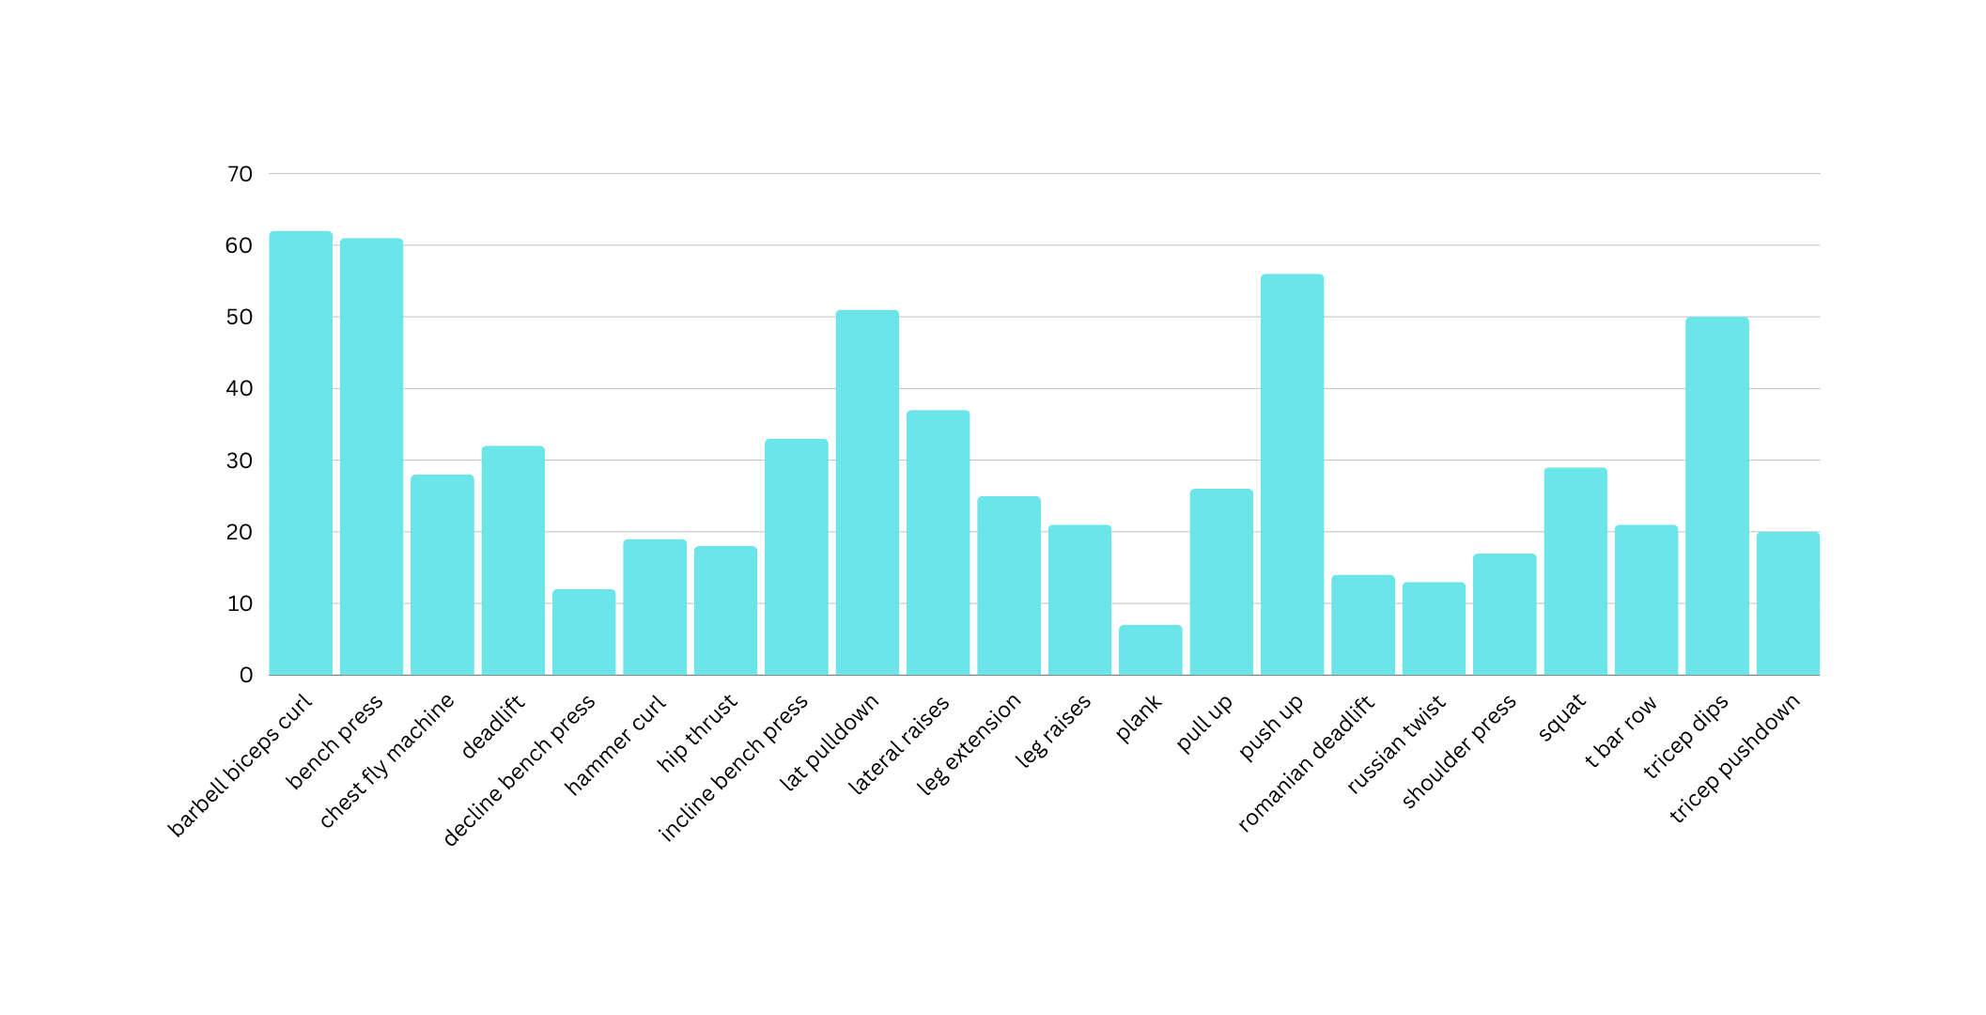
EXERCISES LISTED BELOW
No of videos

Slide 63
EXPECTED DELIVERABLES
AN EFFECTIVE POSTURE ESTIMATION FRAMEWORK THAT FINDS THE BODY KEY POINTS IN EACH FRAME OR IMAGE.
A state-of-the-art exercise classification network that classifies the pose corresponding to the key points.
A cycle repetition counting system that accurately counts repetitions of the exercises detected
Provide insights to the user on the scope of physical activity done during the session

Slide 64
REFERENCES
[1] “Video based exercise recognition and correct pose detection”, Tushar Rangari, Sudhanshu Kumar; Partha Pratim Roy; Debi Prosad Dogra; Byung-Gyu Kim. Multimedia Tools and Applications, 2022.
[2] “A real-time algorithm for weight training detection and correction”, Chen-Yi Lin; Kuan-Cheng Jian. Soft Computing - A Fusion of Foundations, Methodologies and Applications Volume 26 Issue 10 May 2022
[3] “Human pose estimation and action recognition for fitness movements”, Huichen Fu, Junwei Gao, Huabo Liu. Computers & Graphics, September 2023
[4] Jong-Wook Kim ; Jin-Young Choi; Eun-Ju Ha; Jae-Ho Choi. “Human Pose Estimation Using MediaPipe Pose and Optimization Method Based on a Humanoid Model ” in Applied Sciences, 2023.

Slide 65
REFERENCES
[5] Weeriya Supanich; Suwanee Kulkarineetham; Parinya Sukphokha; Patcharathon Wisarnsart. “Machine Learning-Based Exercise Posture Recognition System Using MediaPipe Pose Estimation Framework” in 2023 9th International Conference on Advanced Computing and Communication Systems (ICACCS).
[6] Krishnanunni Raju. “Exercise detection and tracking using MediaPipe BlazePose and Spatial-Temporal Graph Convolutional Neural Network”

